Slide 1
Guilford County Financial
Greg Purvine (gnpurvin)
Vincent Xiao (MrVinegar)
Evan Crabtree (Crabtr)
Rohit Gulia (rohit-gulia)
Cody Cothern (Mask487)

Slide 2
Tasks
Transaction Regression Modelling -> Greg
Budget Anomaly Detection -> Cody
Transaction Anomaly Detection -> Vincent
Probability Distribution -> Rohit
Spending & Probability Distribution By Entity -> Evan

Slide 3
Transaction Regression

Slide 4
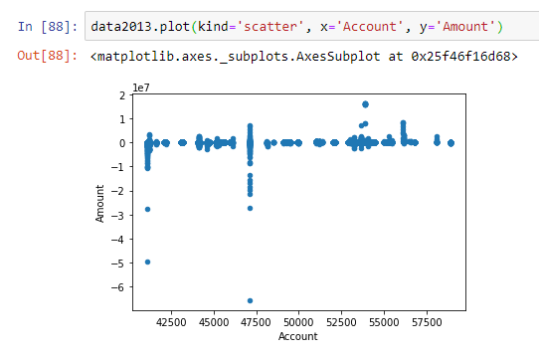
Account x Amount

Slide 5
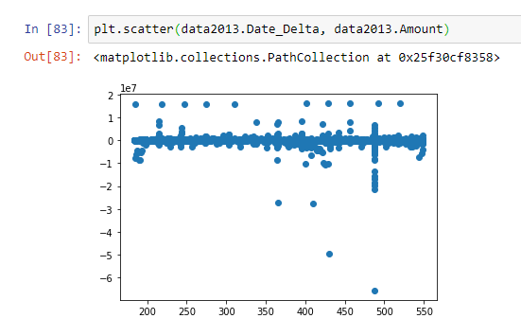
Date x Amount

Slide 6
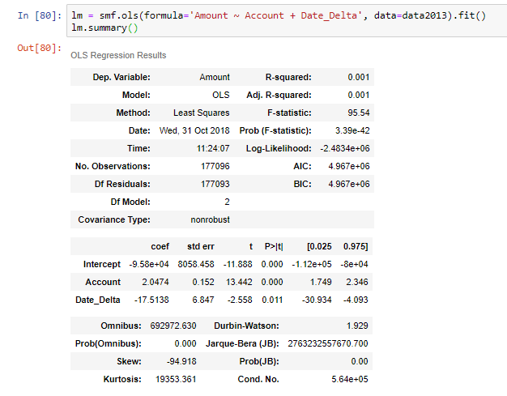
Amount ~ Date + Amount

Slide 7
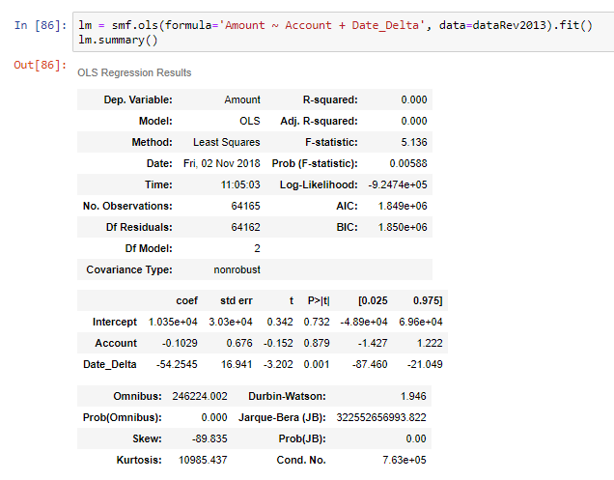
Amount ~ Date + Amount (Revenue)

Slide 8
Transaction Regression
Question: Can we predict/estimate a transaction amount?
Method: Plot transaction data to see if there seems to be any trend.
Outcomes:
Single variable linear regression shows no relation
Plotting by account number or date shows no relation
Multiple linear regression shows no relation
Implications:
Linear regression may not work for transaction data
Next Step: Regression per entity
Note: Transaction data variables mostly categorical

Slide 9
Anomaly Detection

Slide 10
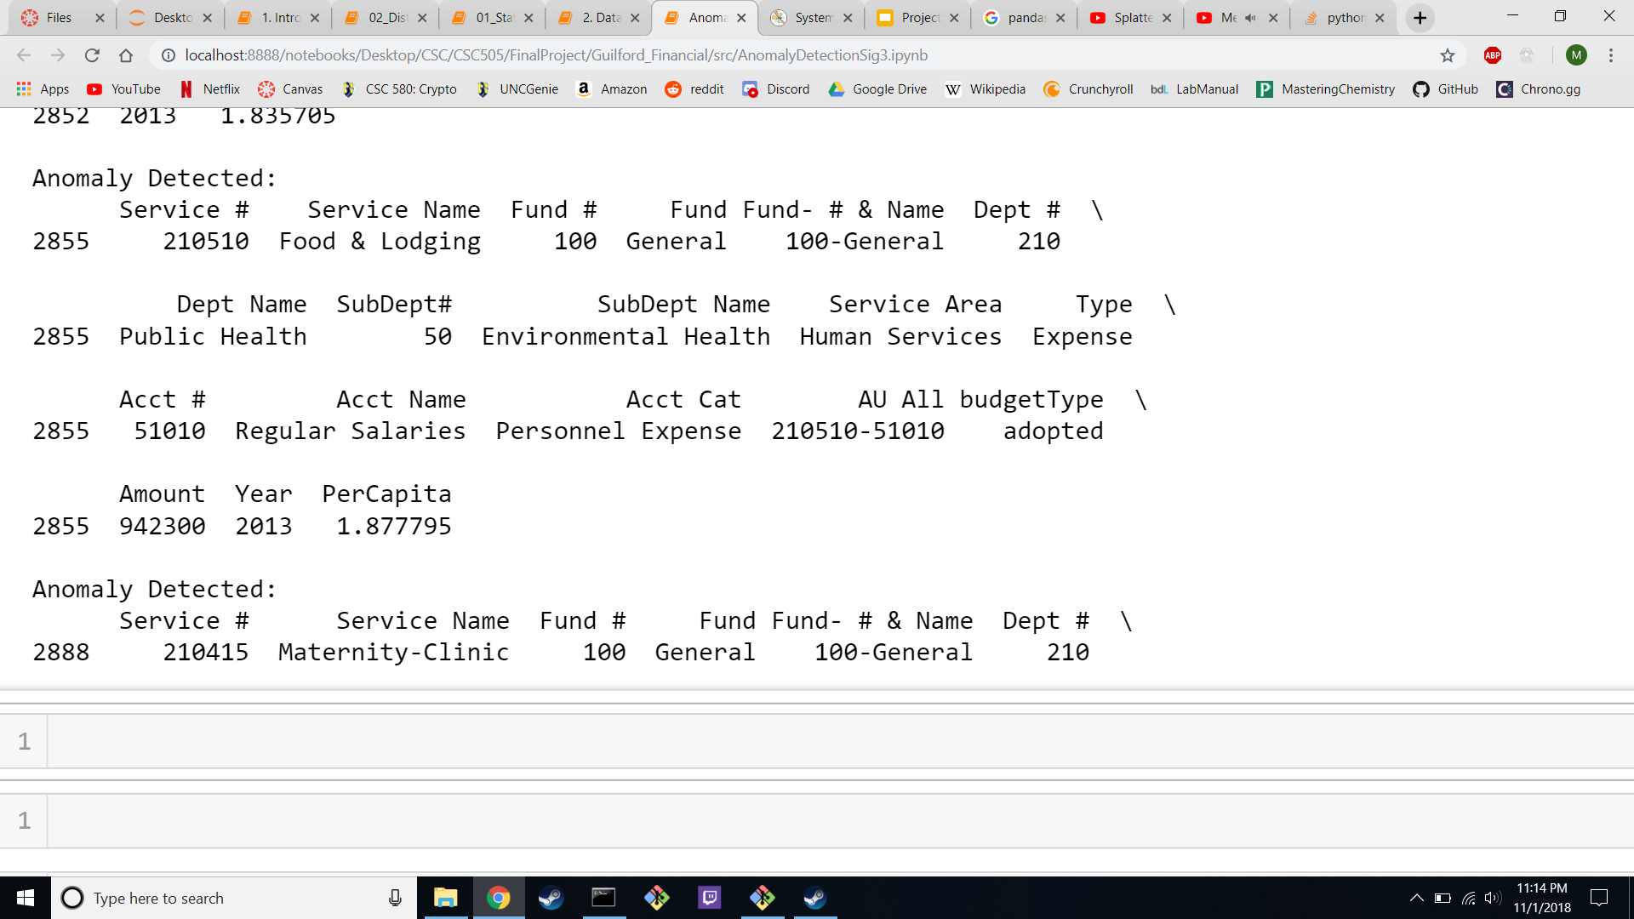

Slide 11
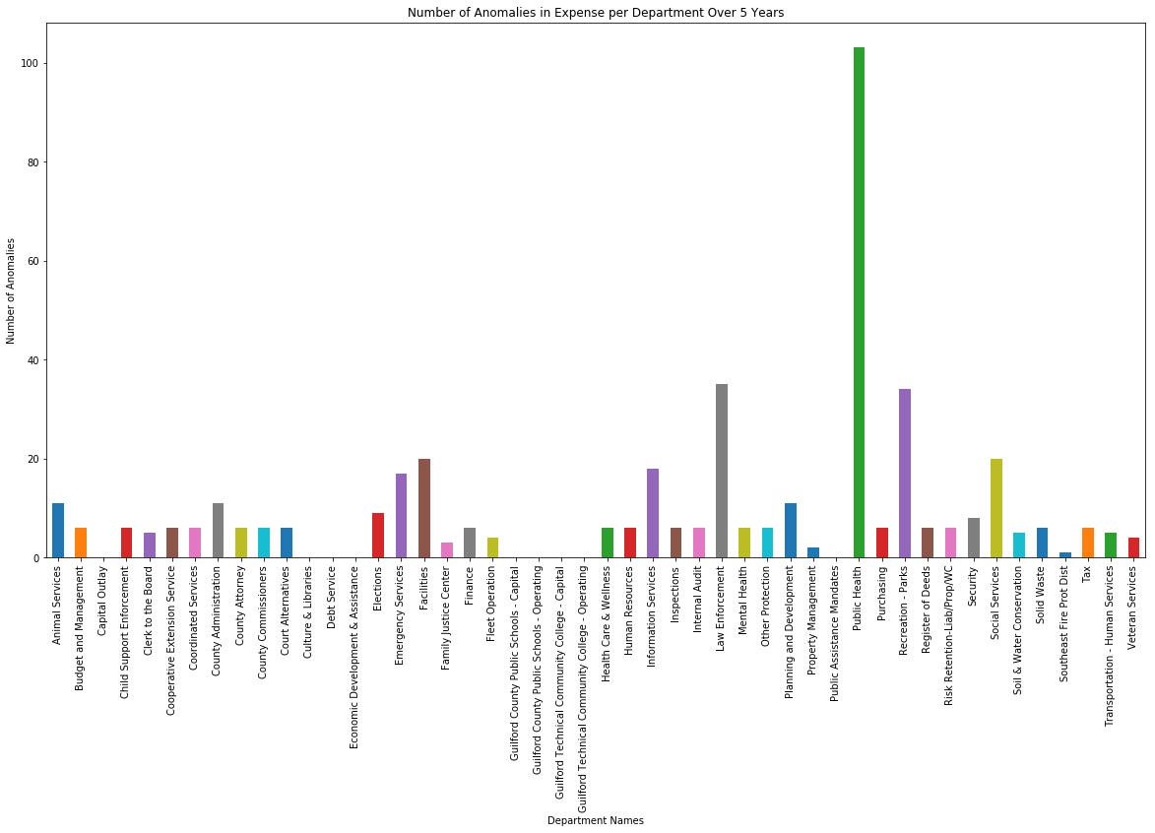

Slide 12
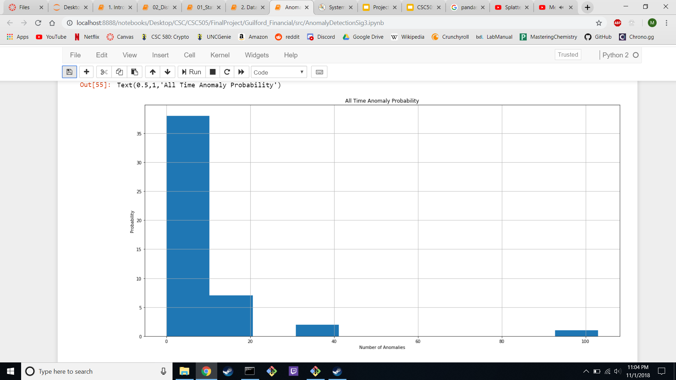

Slide 13
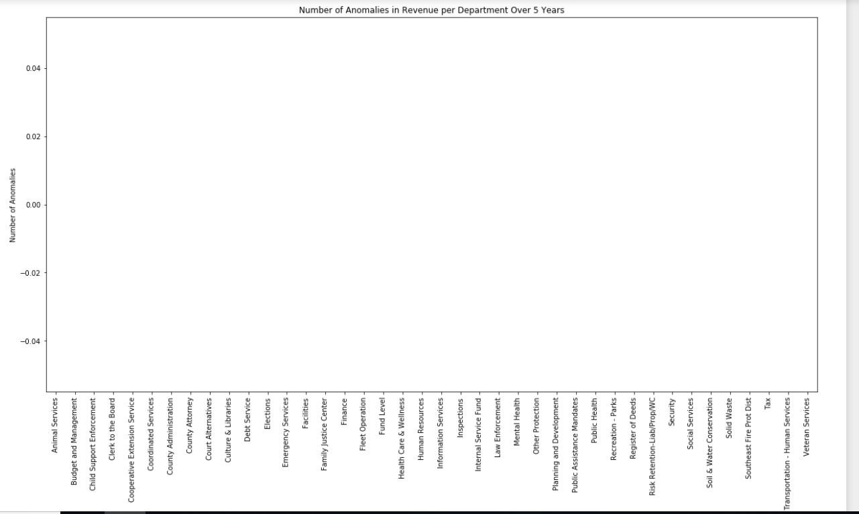

Slide 14
Transaction Anomaly Detection

Slide 15
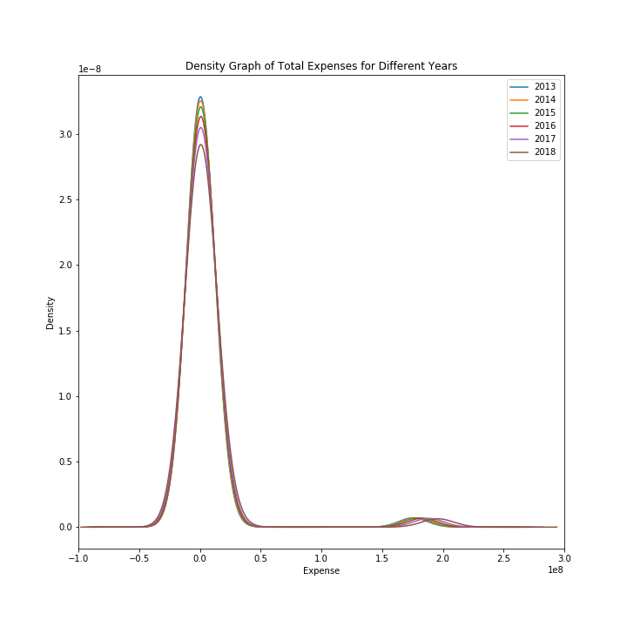
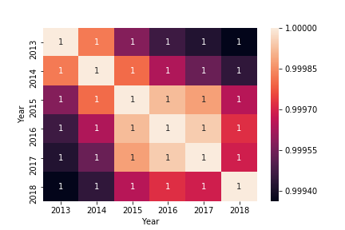
Work Progress

Slide 16
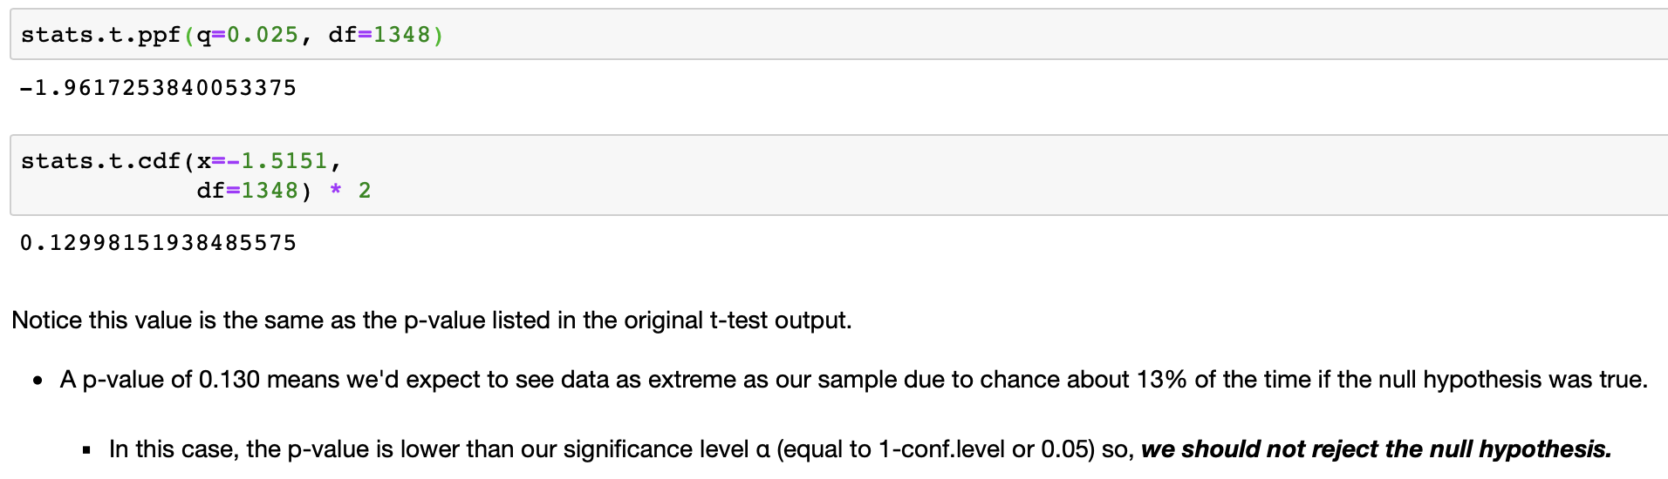
Null Hypothesis Test
One-Sample T-Test
whether the average money spent in 2013 differs from the population:
Null Hypethoesis H0 - 'Total Expenses in 2013 is similar to all expenses'
Alternative Hypothesis H1 - 'Total Expenses in 2013 is different to all expenses'
Ttest_1sampResult(statistic=-1.515156899148224, pvalue=0.12996711371424147)
The test result shows
the test statstic "t" is euqal to -1.515
the p-value is 0.130 (> 0.05)

Slide 17
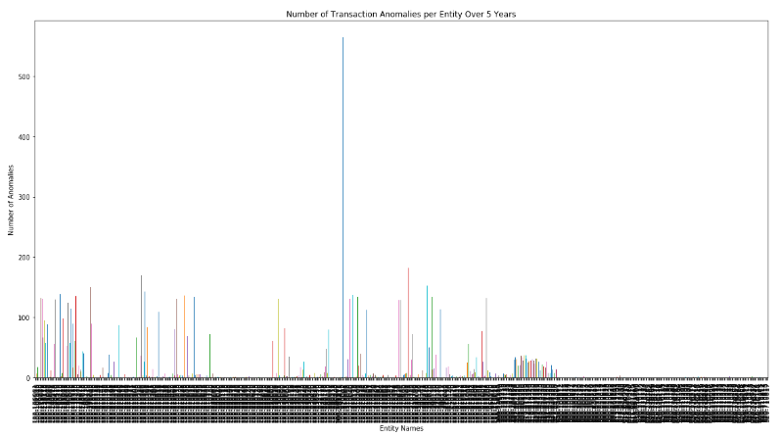
Transaction Anomalies

Slide 18
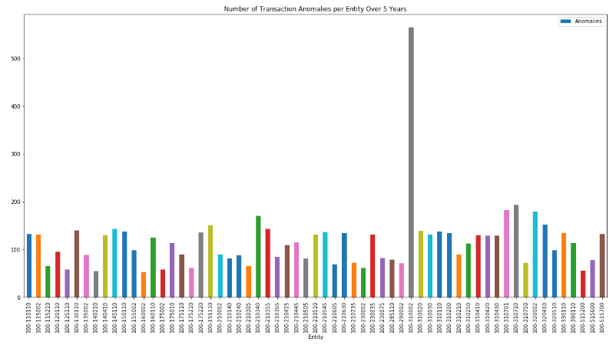
Transaction Anomalies (> 50)

Slide 19
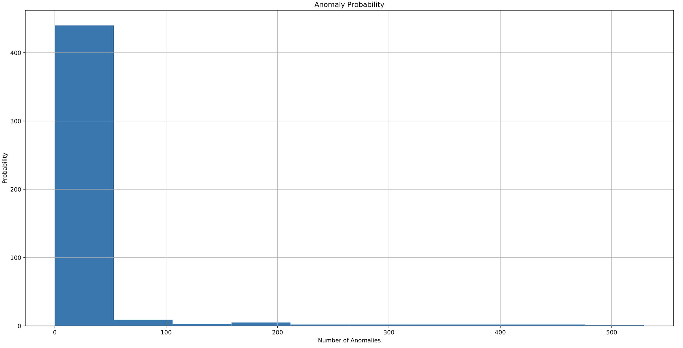
Total Counts of Anomalies

Slide 20
Conclusion for Transaction Anomalies Detection
The probability of the chances of getting anomalies would be helpful towards making null hypothesis.
Steps need to be taken for entity number with large amount of anomalies (eg. 100-310020).
Law Enf Administration
Nearest neighbor techniques
Clustering
Knowing what are the differences between grouping by Entity number and Account number.

Slide 21
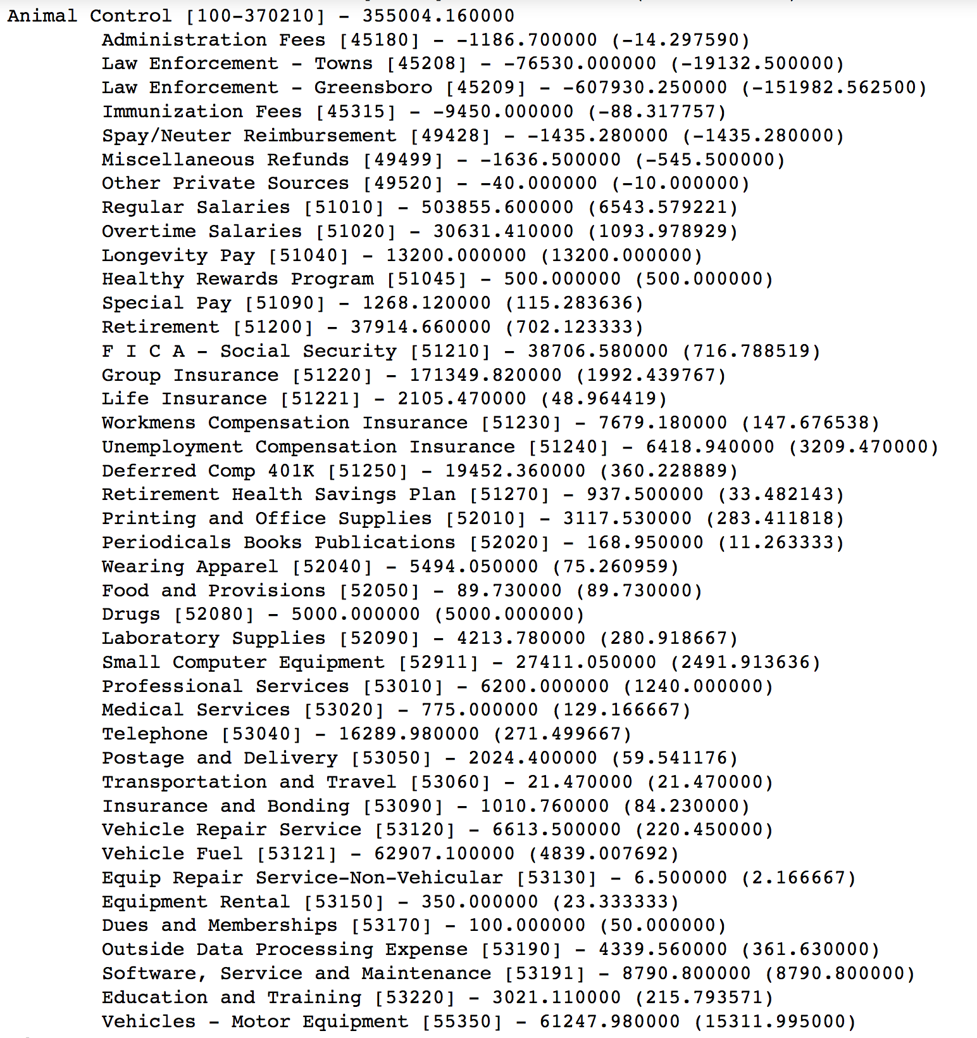
Breaking the transactions down so they’re usable

Slide 22

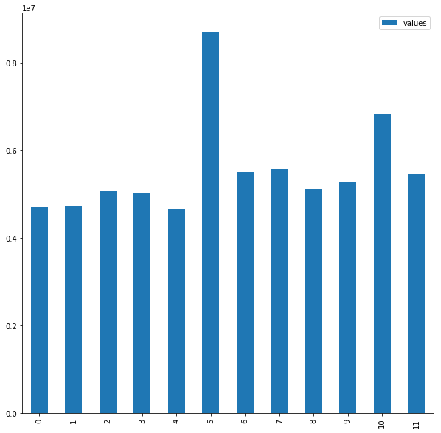
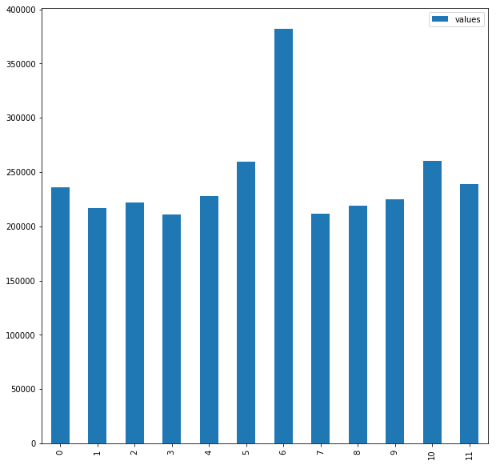
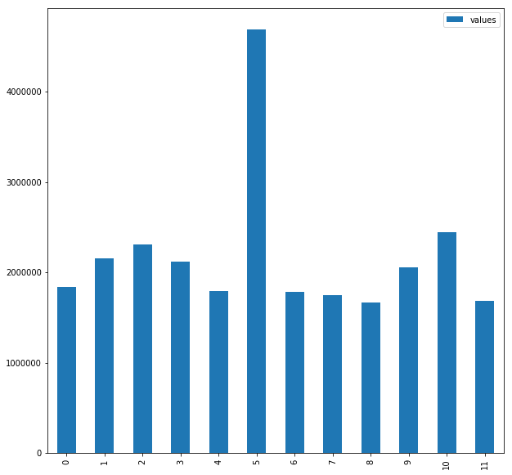
Transactions in 2013 for a few departments grouped by month
Law enforcement animal services emergency services

Slide 23
Probability Distribution

Slide 24
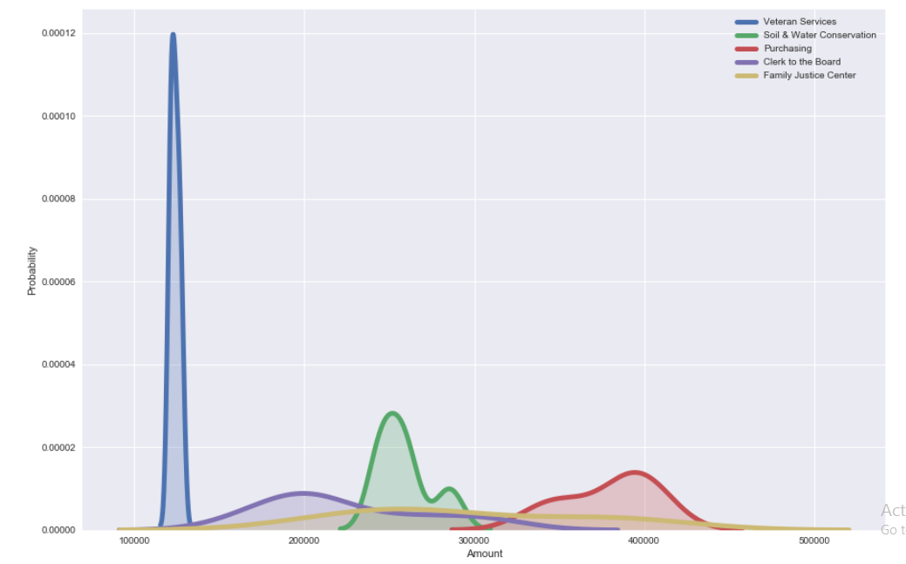
Probability distribution for Top Spending Departments

Slide 25
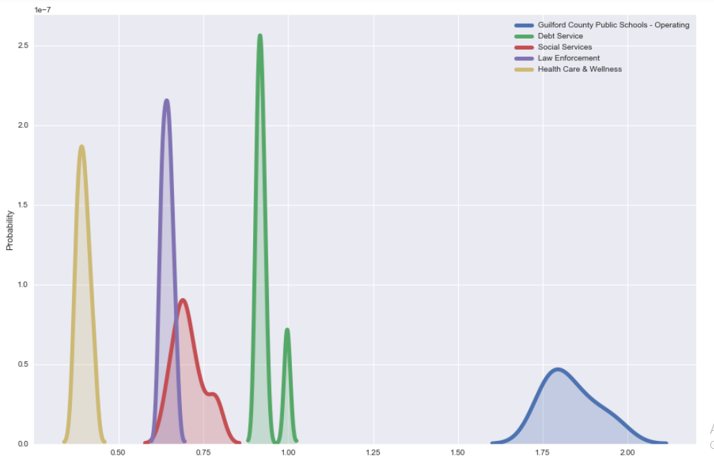
Probability distribution for Least Spending Departments

Slide 26
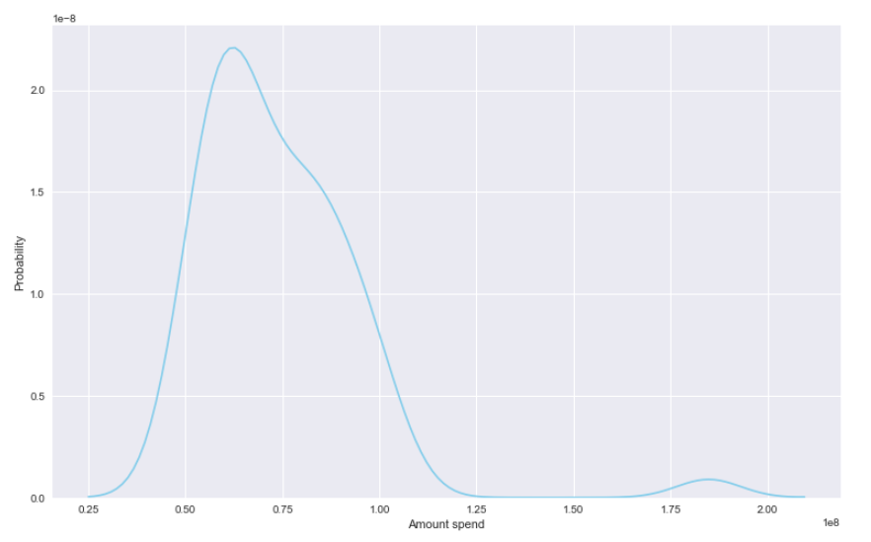
Probability Distribution for Amount Spend

Slide 27
Future work
Additional data cleaning
Unknown accounts
2017 transactions end in June?
In the future we will be working with outliers and anomalies.
Finding where they are coming from or where does that expense made.
Suggesting what could be the future budget of different departments.
Top spending departments and on what services they are spending more.
Any correlation between department budgets.

Slide 28
Thank You

